Slide 1
Workshop and work marketing strategy out

Slide 2
Workshop: 1.step
Thinking about useful products which are unavailable on the market.
Members of the group discuss the ideas properly.
They find out which idea would be the best choice.

Slide 3
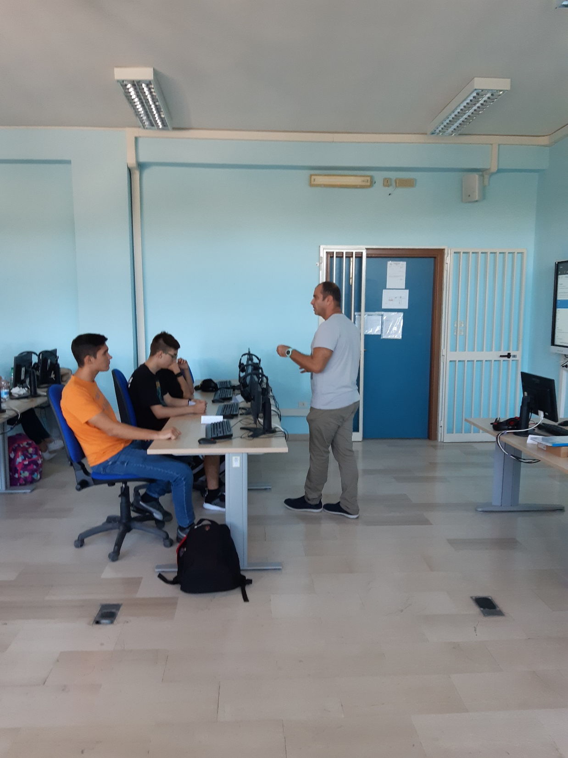

Slide 4
Workshop: 2.step
Market research.
Members search on the net to discover if there is any rival company.
If there is,let’s check what it provides.
At the end, they decide their idea is profitable or not.

Slide 5
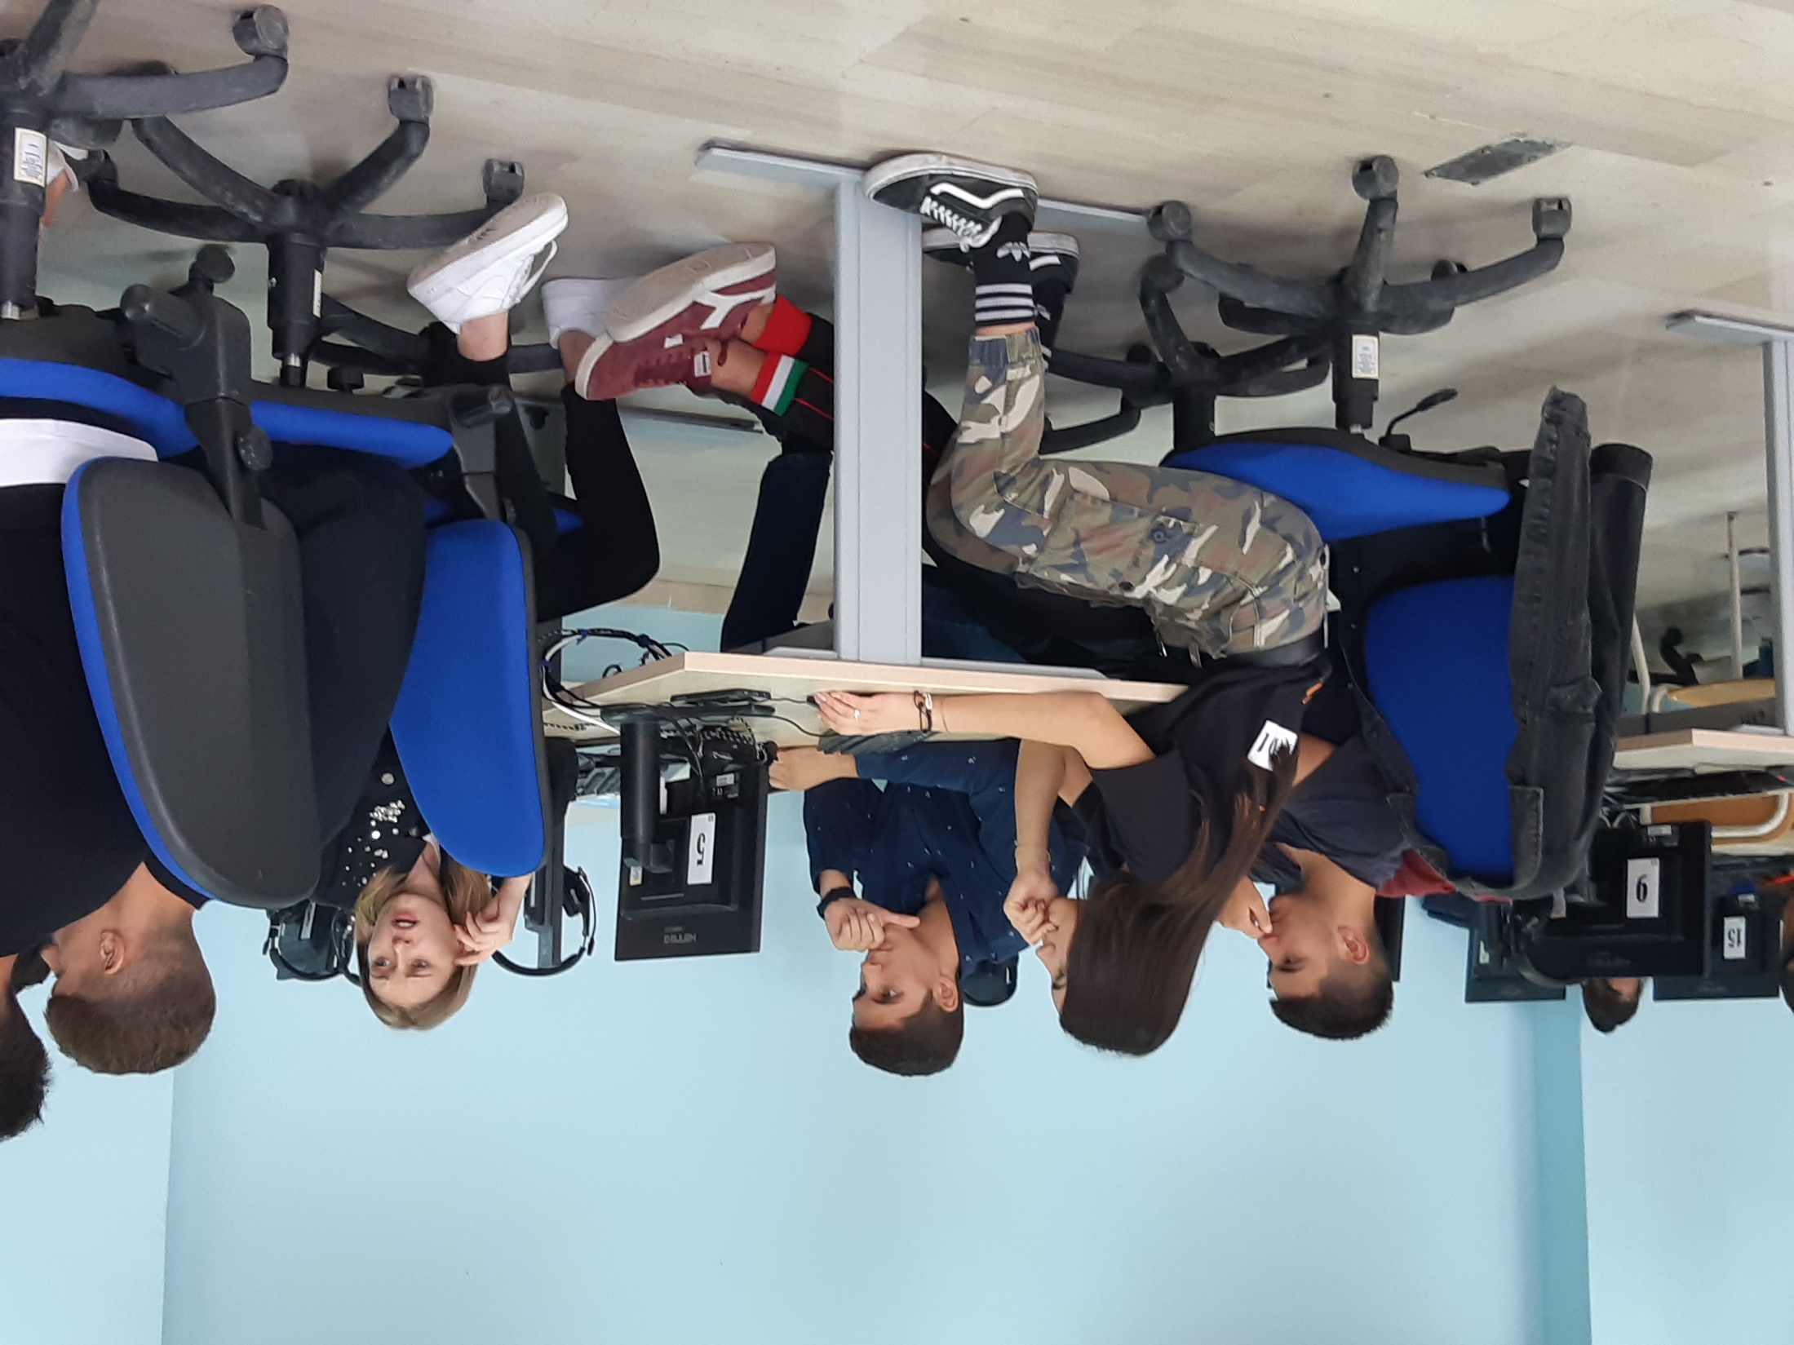

Slide 6
Work marketing strategy out:
With the help of an illustration they plan their product ’s different part of the sale.
For example:Who will be their customer?,How they should transport the goods to the customers? Or Where they should advertise their products?
Last but not at least,members have to thinking about cost of this enterprise and the possible amount of profit that they could earn from this business.
After that they discuss the possibilities and they can decide their product is profitable and competitive or not.

Slide 8
