Slide 1
Patterns of enterprises

Slide 2
Profit oriented structures of enterprises nowadays
Individual proprietorship
Individual company
General partnership
Limited partnership
Limited Liability Company
Public limited company

Slide 3
Individual Companies can be started with minimal capital and simple electronic administration for free, it does not have legal personality but it is inheritable
There is a possibility of transforming into a business organization

Slide 4
‚The way is long and full with troubles, but the profit is waiting for me’
It is advisable to start an individual proprietorship if there is no turnover and/or there is enough cost, as every debit comes from property Sales

Slide 5
An individual company comes to be by the transformation of an individual proprietorship
The notification of an individual proprietorship is quick and easy, it is possible to start the individual company on the next day

Slide 6
The responsibility can be limited or unlimited, it depends on the contractor’s will
In the case of limited responsibilty the amount of additional payment has to be determined in the Statue of the company

Slide 7
In the case of the transformation of an individual company, e.g. after the trasnformation of an ‚eva’ individual proprietorship the company has to wait for 2 years until the individual company can get an ‚eva’-membership

Slide 8
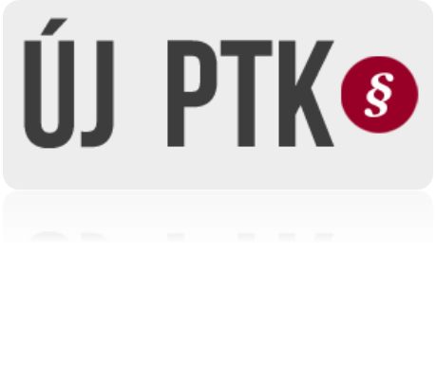
General partnership: usually family run businesses
For the institution at least 2 members are needed who have to pay contribution of property to the company
It is not popular amongst people nowadays

Slide 9
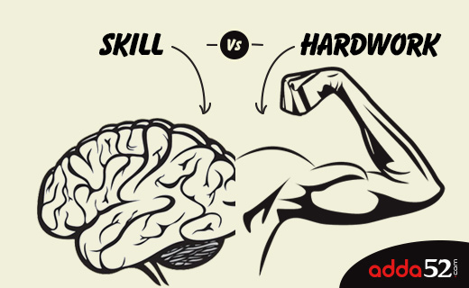
Limited partnership : this kind of business is a combination of an individual proprietorship and a limited liability company
Double entry bookkeeping is compulsory and it is under the scope of Accounting act
People consider it the most difficult kind of business form, because of the double entry bookkeeping, and it also needs special skills, experience and hard-working

Slide 10
Limited liablity company: as the transformation is usually expensive and difficult, it is advisable to start a limited liability company , if the owners predict huger money turnover or the image of the company is essential
In the case of starting a LLC a bigger starting cost is needed, although it provides a safer financial background for clients , it shows a serious attitude
Nowadays the starting cost is min. 3,000,000 Ft

Slide 11
Public limited company: a business organization that borns with a fund that was made by pretermined number and par value of shares
By functional form we distinguish open and closed public limited companies, the open ones tend to be giant companies and the closed ones are usually middle sized

